Slide 1

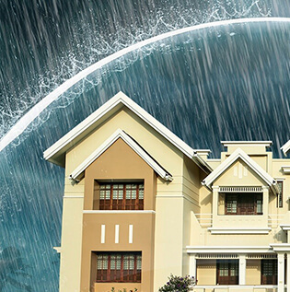


AQUASHIELD SOLUTIONS
Protecting your property, one drop at a time.
By Faridah Kaberia , CEO&Founder

Slide 2

PROBLEM
Current Issues:
Water damage is a leading cause of property damage.
Traditional waterproofing methods are often ineffective and short-lived.
Climate change is increasing the frequency and severity of floods.

Slide 3
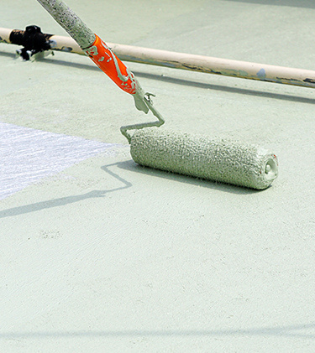
SOLUTION
Advanced, durable waterproofing technology.
Eco- friendly materials that offer long-term protection.
Comprehensive services for residential, commercial and industrial properties.

Slide 4
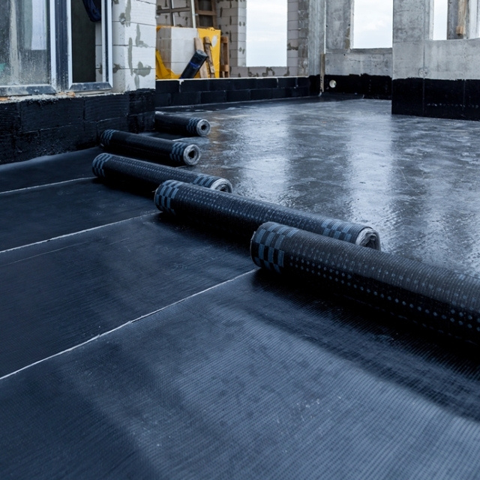
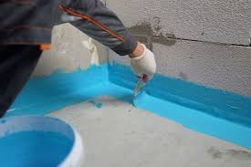
PRODUCTS
Our Services:
Basement and foundation waterproofing.
Roof and terrace waterproofing.
Bathroom and kitchen waterproofing.
Customized solutions for industrial applications.
05

Slide 5

TARGET MARKET
Residential:
Homeowners looking to protect their investments from water damage.
Commercial:
Businesses seeking to maintain the integrity of their buildings and ensure operational continuity.
Industrial:
Manufacturing plants and facilities requiring specialized waterproofing solutions to withstand harsh conditions.
Government & Institutional:
Public buildings and infrastructure needing reliable waterproofing to ensure safety and functionality.

Slide 6

MARKET SIZE
Global waterproofing market expected to reach $72 billion by 2025.
Growing demand for home renovations and upgrades.
Increased construction activity and focus on building maintenance.
Expansion of manufacturing and industrial facilities.
Public infrastructure projects and investments in building maintenance.

Slide 7

COMPETITION
Traditional Waterproofing Companies
Established players with experience in the industry but may lack innovative solutions.
Specialty Waterproofing Firms
Smaller companies focusing on specific areas of expertise, offering niche solutions.
Technology-Driven Companies
New entrants using advanced materials and techniques to deliver efficient and sustainable solutions.
Local Contractors
Smaller businesses operating in specific geographic areas, offering personalized service and competitive pricing.

Slide 8

COMPETITIVE ADVANTAGE
Unique selling points:
Expertise & Experience
Our team of engineers and technicians has extensive experience in waterproofing and offers tailored solutions for diverse needs.
Quality Materials & Techniques
We use high-quality materials from reputable manufacturers and employ advanced waterproofing techniques for lasting protection.
Customer Focus & Service
We prioritize customer satisfaction, offering personalized consultations, transparent pricing, and reliable project management.
Sustainable Practices
We are committed to environmentally responsible practices, using eco-friendly materials and minimizing waste during projects.

Slide 9

TRACTION: Early Success
Completed 50+ projects for residential, commercial and industrial clients.
Our clients consistently express satisfaction with our services, resulting in repeat business and referrals.
Secured partnerships with three major construction firms.
Recognized by industry leaders for innovation and sustainability.

Slide 10

BUSINESS MODEL: Value driven & Sustainable
Customer Acquisition:
We utilize various marketing channels, including online advertising, networking, and referral programs, to reach potential clients.
Project Execution:
We offer comprehensive waterproofing solutions, from consultation and design to installation and maintenance, ensuring quality and efficiency.
Revenue Generation:
We generate revenue through project fees, based on the scope of work and materials used, providing transparent and competitive pricing.

Slide 11

GO-TO-MARKET STRATEGY
Digital Marketing
Leverage SEO, social media, and online advertising to reach potential customers.
Partnerships
Collaborate with construction companies, real estate agents, and home improvement professionals.
Community Engagement
Participate in local events, sponsor community projects, build brand awareness.
Content Marketing
Create informative blog posts, videos, and guides to educate customers about waterproofing.

Slide 12

FINANCIAL PROJECTIONS
Key Metrics:
Year 1: $100K in revenue.
Year 2: $500K million in revenue.
Year 3: $1 million in revenue, opening more branches.

Slide 13

SOCIAL IMPACT
Protecting Properties
Our services help prevent water damage, protecting homes and businesses from costly repairs.
Ensuring Health & Safety
By preventing mold growth, we contribute to a healthier and safer living environment for families.
Strengthening Communities
Our work helps maintain property values, contributing to the overall well-being of communities.

Slide 14

FUNDING ASK
Investment Needs:
Seeking $500K in seed funding for 10% equity.
Allocation: 40% technology development, 30% marketing, 20% operations, 10% reserve.

Slide 15

TEAM
CEO: Faridah Kaberia, Waterproofing Expert.
COO: Kevin Wachira, Construction Management Professional.

Slide 16


THANK YOU
JOIN US
Contact +254712345678 or email aquashieldsolutions@gmail.com to schedule a meeting.

